Slide 1

PROJECT PROPOSAL
PROJECT 01-GROUP 04
Genetic interactions and cancer cell survival: Breast Cancer
Elias Farr, Lennart Linke, Lisa Marie Milchsack & Salome Steinke
Notes:
Let´s get into this: Quick welcome phrase; we chose Breast cancer
Thank u, next slide

Slide 2

INCIDENCE & MORTALITY
About
70,000
new cases
annually
30.5%
Most
Common
cancer type in women
About
18,000
caused deaths
annually
Source: Zentrum für Krebsregisterdaten; Robert-Koch Institut: “Krebs in Deutschland | 2013/2014 | Brustdrüse C50“ Image: medium.com
Notes:
Quick Facts to show relevance

Slide 3


DRIVERS OF TUMORGENESIS
Driver Mutation
Main factor
in tumorgenesis
Growth advantage
Positive selection in microenvironment
Often required for tumor maintenance
Source: (Stratton, Campbell et al. 2009)
Notes:
Distinction between those two mutations;
Passenger mutations describe somatic mutations without functional consequences in cancer, often occur during cell division.
Will be “carried along” in the tumor development, therefore present in all cells of the final cancer.
Our focus on Drivers, as main “force” in tumorgenesis.

Slide 4
POSSIBLE DRIVER MUTATIONS
0.1
0.2
0.3
0.4
0.5
OF OBSERVED CASES
0.6
CCND
Cell cycle regulator
50%
PIK3CA
Interaction with AKT and mTOR pathway
30%
48%
PARP
Regulates differentiation, proliferation and recovery from DNA damage
45%
MYC
30%
50%
Cell cycle and apoptosis regulator
ERBB2
Encodes endothelial growth factor
30%
Source: genecards.com
Notes:
5 selected Drivers: Selection factors include: overexpression in breast cancer; observed in a relevant percentage of clinical cases.
5 Genes also impact a variety of factors in tumorgenesis
CCND: Cyclin D1; downregulates tumor repressor RB1
PIK3CA: Phosphatidylinositol-4,5-Bisphosphate 3-Kinase Catalytic Subunit Alpha
PARP: Poly(ADP-Ribose)-Polymerase 1
MYC: MYC Proto-Oncogene (alterations include the overexpression of BCL-2, loss of p53 or p19ARF.
linked to oncogene-addiction in breast cancer)
ERBB2: Erb-B2 Receptor Tyrosine Kinase 2; also called HER2 (more aggressive breast cancer, demands special treatment)

Slide 5
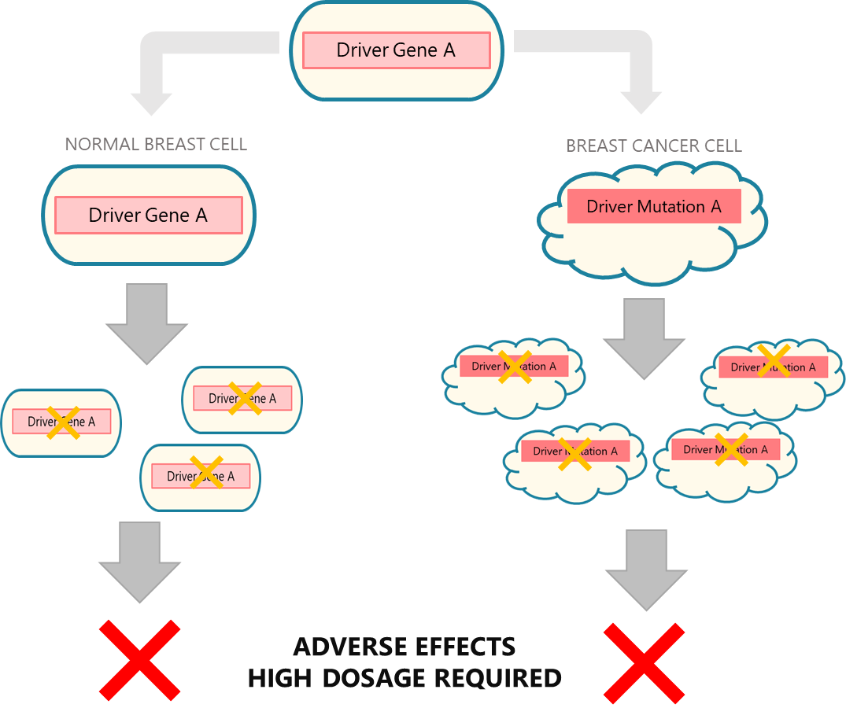
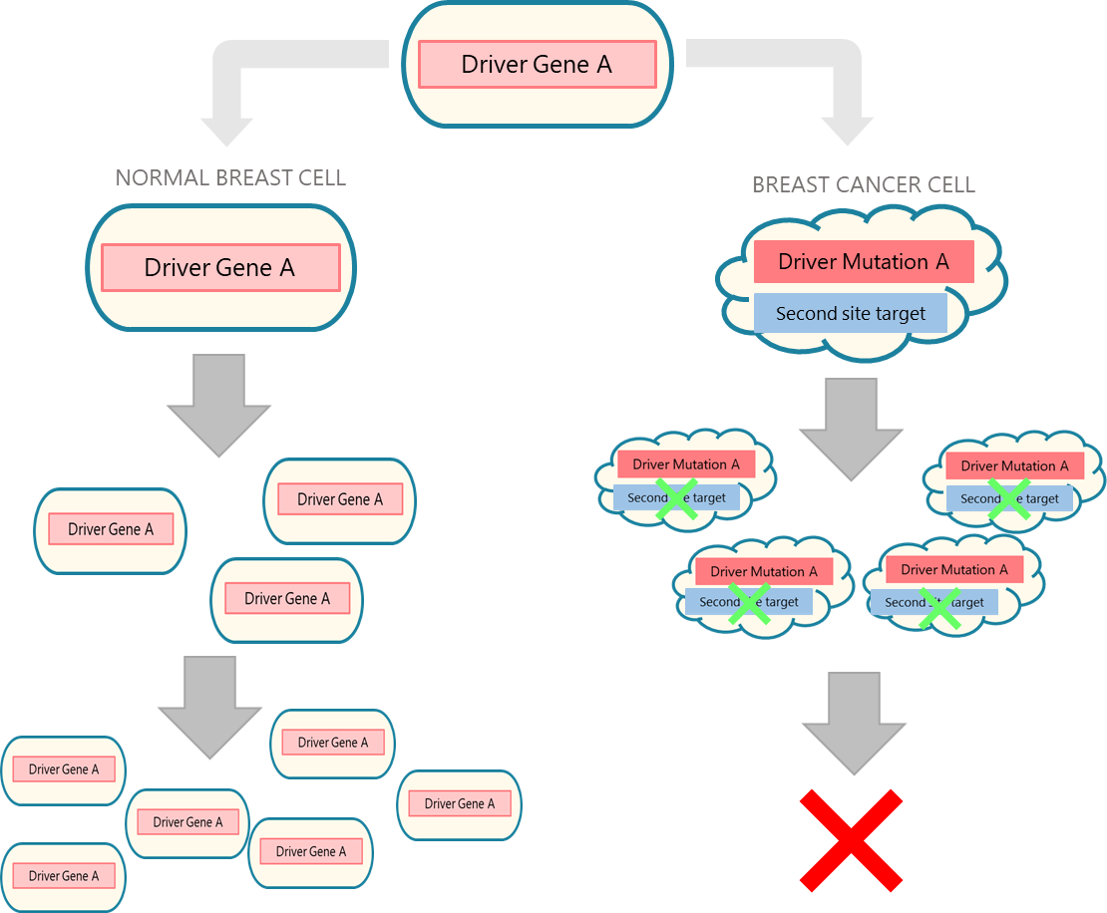
SECOND SITE TARGETS
GENE MUTATIONS INTERACTING GENETICALLY WITH DRIVER MUTATIONS TO INCREASE CELL VIABILITY

Slide 6

MAIN QUESTION
WHICH SECOND-SITE TARGETS INTERACT GENETICALLY WITH DRIVER MUTATIONS TO PROMOTE CELL VIABILITY AND PROLIFERATION IN BREAST CELL CANCERS?

Slide 7
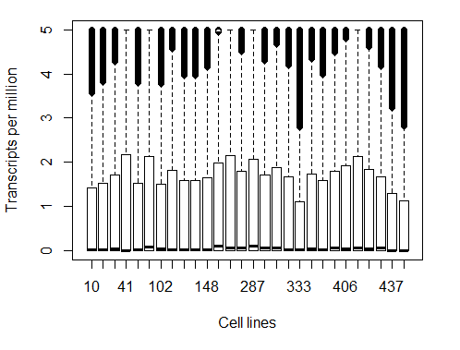
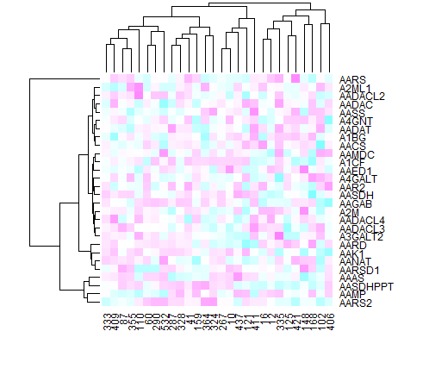
DATA EXPLORATORY & CLEANING
Expression values are distributed equally, but there are a lot of NAs in the dataset
Heatmap of CERES-scores show the impact on cell viability off different Genes

Slide 8
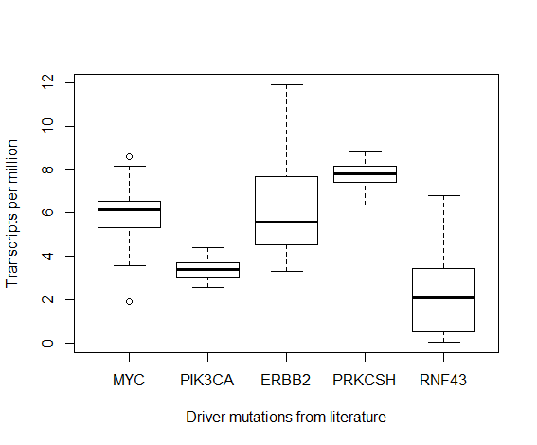
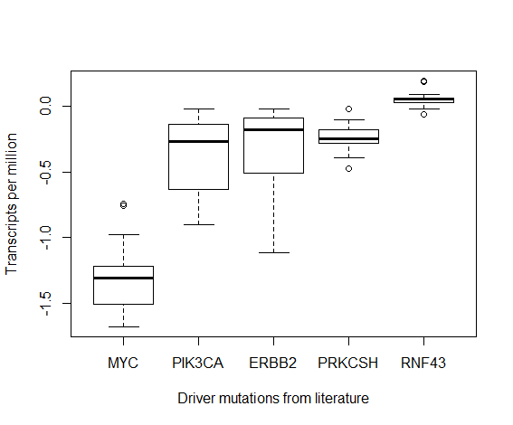
ESSENTIAL DRIVER MUTATIONS
Derived from PCA
Found in literature

Slide 9
FURTHER BREAKDOWN
01
Which essential driver mutations for breast cancer development are also indispensable for cell viability in given cell lines?
02
Which gene mutations (potential second site targets) are co-expressed with driver mutations in the identified cell lines?
03
Which gene mutations correlate with driver mutations in their effect of increasing cell viability?
04
What characteristics do the identified second site targets have?
05
Can CERES scores of second site targets be used to predict CERES scores of driver mutations?

Slide 10


TIME & MILESTONES
IDENTIFICATION OF SECOND-SITE TARGETS
12th June
5th July
GENERAL DATA EXPLORATION
FINAL PRESENTATION
Find mutations of which the effect strongly correlates with the effect of driver mutation.
Get an overview over expression patterns and effects on viability.
Present findings and implications for further research.
SELECTION OF DRIVER MUTATION
PREDICTION OF INTERACTION
Predict effect of driver mutation in interaction with second-site targets.
Select overexpressed or gain-of-function mutations promoting viability.
29th May
26th June
24th July

Slide 11
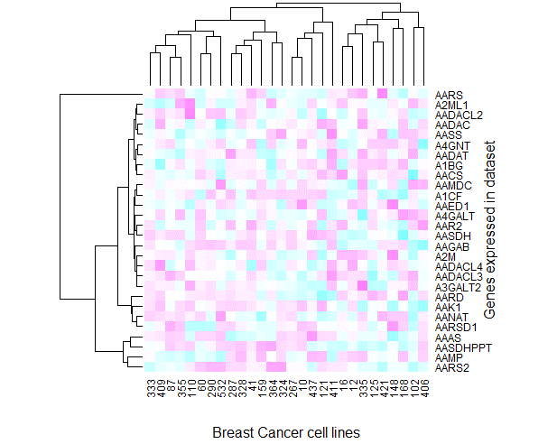
TIME & MILESTONES
GENERAL DATA EXPLORATION
Get an overview over expression patterns and effects on viability.
29th May

Slide 12
TIME & MILESTONES
GENERAL DATA EXPLORATION
Get an overview over expression patterns and effects on viability.
Which essential driver mutations for breast cancer development are also indispensable for cell viability in given cell lines?
Which gene mutations (potential second site targets) are co-expressed with driver mutations in the identified cell lines?
Which gene mutations correlate with driver mutations in their effect of increasing cell viability?
29th May

Slide 13
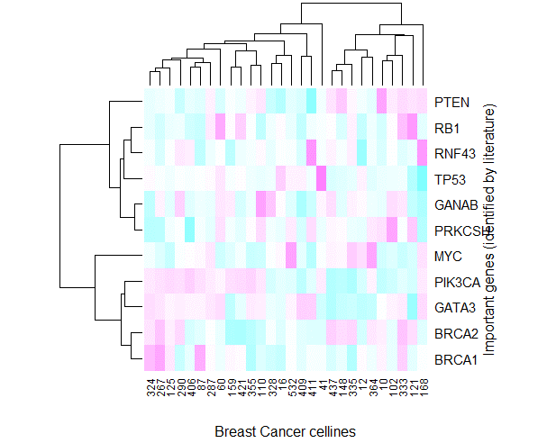
TIME & MILESTONES
Find most important genes in dataset via Expression-PCA:
Visualize them with a heatmap, showing their Ceres score in different cell lines.
K-means clustering is considered for analysis of specific subgroups.
GENERAL DATA EXPLORATION
Get an overview over expression patterns and effects on viability.
29th May

Slide 14
TIME & MILESTONES
IDENTIFICATION OF SECOND-SITE TARGETS
12th June
5th July
GENERAL DATA EXPLORATION
FINAL PRESENTATION
Find mutations of which the effect strongly correlates with the effect of driver mutation.
Get an overview over expression patterns and effects on viability.
Present findings and implications for further research.
SELECTION OF DRIVER MUTATION
PREDICTION OF INTERACTION
Predict effect of driver mutation in interaction with second-site targets.
Select overexpressed or gain-of-function mutations promoting viability.
29th May
26th June
24th July

Slide 15
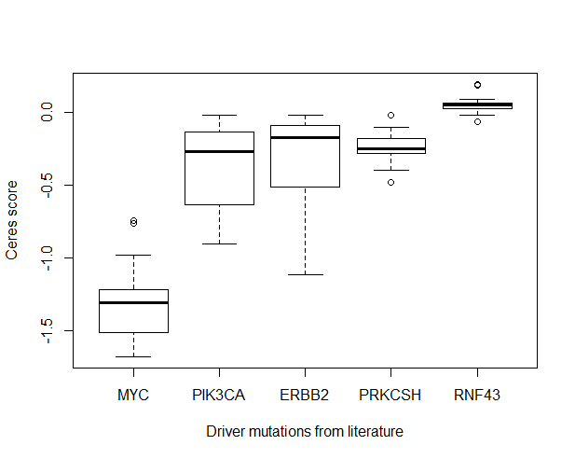
TIME & MILESTONES
For further analysis, single driver mutation have to be picked:
Mutation should be in intersection between data from dataset and information found in literature.
12th June
DRIVER MUTATIONS
Derived from PCA
Found in literature
SELECTION OF DRIVER MUTATION
Select overexpressed or gain-of-function mutations promoting viability.
Notes:
PCA um wichtige gene zu finden. Von denen nehmen wir die mutiert sind. Das heißt aber nur, dass die auf die genexpression einen impact haben. Deshalb ceres scores überprüfen.
Und die vergleichen wir mit der literatur

Slide 16
TIME & MILESTONES
IDENTIFICATION OF SECOND-SITE TARGETS
12th June
5th July
GENERAL DATA EXPLORATION
FINAL PRESENTATION
Find mutations of which the effect strongly correlates with the effect of driver mutation.
Get an overview over expression patterns and effects on viability.
Present findings and implications for further research.
SELECTION OF DRIVER MUTATION
PREDICTION OF INTERACTION
Predict effect of driver mutation in interaction with second-site targets.
Select overexpressed or gain-of-function mutations promoting viability.
29th May
26th June
24th July

Slide 17
TIME & MILESTONES
IDENTIFICATION OF SECOND-SITE TARGETS
generate mutImpact matrix with mutated genes and corresponding CERES values:
generate filter matrix with information on presence of mutations in breast cancer cell lines
generate mutImpact matrix: replace CERES scores with “NA” for genes which are not mutated in the given cell line by applying the filter matrix
Find mutations of which the effect strongly correlates with the effect of driver mutation.
filter matrix
mutImpact matrix
Cell lines
mutations | X | - | X | X | -
 | - | X | - | - | X
 | - | - | X | X | X
 | X | - | - | - | -
 | X | X | - | X | X
Cell lines
Ceres scores | -2.5 | 0 | … | … | …
 | 0.3 | … | … | … | …
 | -0.2 | … | … | … | …
 | -1.7 | … | … | … | …
 | … | … | … | … | …
Cell lines
Mutations/ceres | -2.5 | NA | … | … | NA
 | NA | … | NA | NA | …
 | -0.2 | NA | … | … | …
 | -1.7 | NA | NA | NA | NA
 | … | … | NA | … | …
+
→
26th June

Slide 18
TIME & MILESTONES
IDENTIFICATION OF SECOND-SITE TARGETS
generate mutImpact matrix with mutated genes and corresponding CERES values:
generate filter matrix with information on presence of mutations in breast cancer cell lines
generate mutImpact matrix: replace CERES scores with “NA” for genes which are not mutated in the given cell line by applying the filter matrix
Find mutations of which the effect strongly correlates with the effect of driver mutation.
mutImpact matrix
driver mutation
Cell lines
Mutations/ceres | -2.5 | NA | … | … | NA
 | NA | … | NA | NA | …
 | -0.2 | NA | … | … | …
 | -1.7 | NA | NA | NA | NA
 | … | … | NA | … | …
potential SST
K-means clustering:
find optimal number of clusters k by use of elbow method
identify chosen driver mutation
identify potential SSTs in neighborhood of driver mutation
26th June

Slide 19
TIME & MILESTONES
IDENTIFICATION OF SECOND-SITE TARGETS
mutImpact matrix
driver mutation
Cell lines
Mutations/ceres | -2.5 | NA | … | … | NA
 | NA | … | NA | NA | …
 | -0.2 | NA | … | … | …
 | -1.7 | NA | NA | NA | NA
 | … | … | NA | … | …
Find mutations of which the effect strongly correlates with the effect of driver mutation.
potential SST
SST1
K-means clustering:
find optimal number of clusters k by use of elbow method
identify chosen driver mutation
identify potential SSTs in neighborhood of driver mutation
Paired Wilcoxon signed rank test:
calculate t-value of CERES scores of driver mutation with other mutations
apply correction based on sample size (either Bonferroni or Benjamini Hochberg)
identify SSTs according to highest p-values
26th June

Slide 20
TIME & MILESTONES
IDENTIFICATION OF SECOND-SITE TARGETS
mutImpact matrix
driver mutation
Cell lines
Mutations/ceres | -2.5 | NA | … | … | NA
 | NA | … | NA | NA | …
 | -0.2 | NA | … | … | …
 | -1.7 | NA | NA | NA | NA
 | … | … | NA | … | …
Find mutations of which the effect strongly correlates with the effect of driver mutation.
potential SST
SST1
characterization of SSTs:
type of mutations (e.g. deletion)
expression patterns (e.g. overexpression)
copy number (e.g. amplification)
compare impact of intact gene to impact of mutated gene
26th June

Slide 21
TIME & MILESTONES
IDENTIFICATION OF SECOND-SITE TARGETS
12th June
5th July
GENERAL DATA EXPLORATION
FINAL PRESENTATION
Find mutations of which the effect strongly correlates with the effect of driver mutation.
Get an overview over expression patterns and effects on viability.
Present findings and implications for further research.
SELECTION OF DRIVER MUTATION
PREDICTION OF INTERACTION
Predict effect of driver mutation in interaction with second-site targets.
Select overexpressed or gain-of-function mutations promoting viability.
29th May
26th June
24th July

Slide 22
TIME & MILESTONES
5th July
Predict impact of driver mutation based on SST background:
by multilinear regression: impact on viability of driver mutation as a function of impact of SSTs
serves as an indication for interaction of driver mutation and its SSTs
${impact}_{driver mut.}=f({impact}_{SST1},$ ${impact}_{SST2}$, ${impact}_{SST2}$ …)
PREDICTION OF INTERACTION
Predict effect of driver mutation in interaction with second-site targets.

Slide 23
TIME & MILESTONES
IDENTIFICATION OF SECOND-SITE TARGETS
12th June
5th July
GENERAL DATA EXPLORATION
FINAL PRESENTATION
Find mutations of which the effect strongly correlates with the effect of driver mutation.
Get an overview over expression patterns and effects on viability.
Present findings and implications for further research.
SELECTION OF DRIVER MUTATION
PREDICTION OF INTERACTION
Predict effect of driver mutation in interaction with second-site targets.
Select overexpressed or gain-of-function mutations promoting viability.
29th May
26th June
24th July

Slide 24
Any QUESTIONS ?

